Slide 1

Stagflation?
Jeffrey Frankel
Harpel Professor of Capital Formation and Growth
Harvard University.
Eaton Vance Research Retreat,
December 7, 2021.

Slide 2
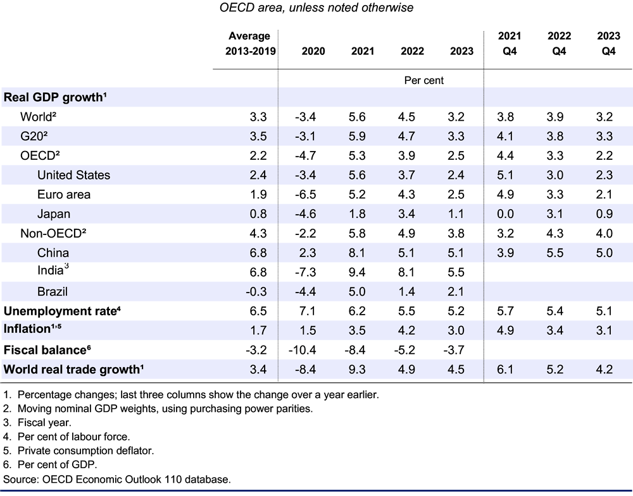
OECD Economic Outlook,
Dec. 2021, no.2:
Preliminary version.
Responding to 1st Omicron reports, the OECD cut 2022 forecasts of world growth to 4.5%,
& raised inflation
to 4.2%.
Even so,
growth > 2013-19.
“Stagflation”?
No “stag.”
Just inflation.

Slide 3
Possible risks to the global economy
● US “stagflation,” as in the 1970s?
● EM debt crises, as in 1982-2018?
● Bursting of the “everything bubble,” as in 2008?
● Hard landing in China, as other Asians in 1990s?
● Losing the race between vaccination & more
dangerous coronavirus variants? Omicron...

Slide 4
● 1. The US is not experiencing stagflation,
  defined as a combination of worrisome inflation
  with slow growth in GDP & employment;
  rather, moderate inflation with strong growth (like the 1960s).
  Will inflation accelerate (like the 1970s)? Unlikely.
  Thus, inflation is “a good problem to have,”
    like the trade deficit.
  We are seeing the results of a rapid recovery of demand,
      temporarily outpacing the recovery of supply
      (bottlenecks, supply-chain disruption, reduced LFPR…).

Slide 5
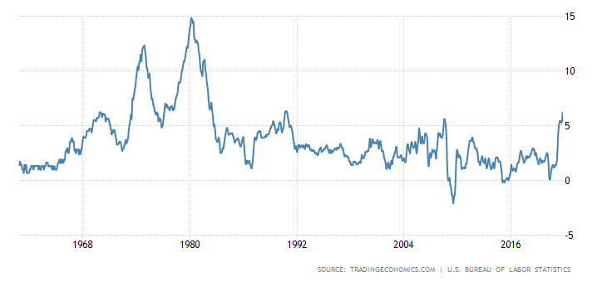
Summers & Blanchard’s Feb. inflation predictions turned out right:
5 % inflation, back to 1969 or 2007,
but still far below 1974 or 1980.
US CPI Inflation,
1960- Oct. 2021
12 mo.s to Oct.: 6.2%.
Core: 4.6%.

Slide 6
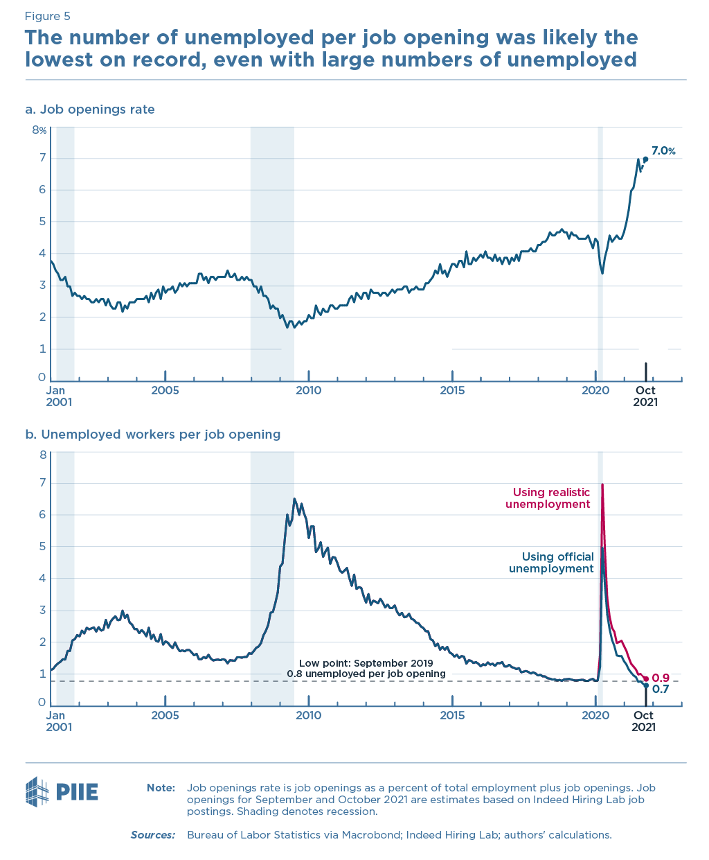
No stagnation: GDP & employment are strong.
As of October 2021: 4-Q GDP growth = 5.0%; unemployment = 4.2%.
Unemployed workers per job opening is the lowest on record.
Jason Furman, November 2021

Slide 7
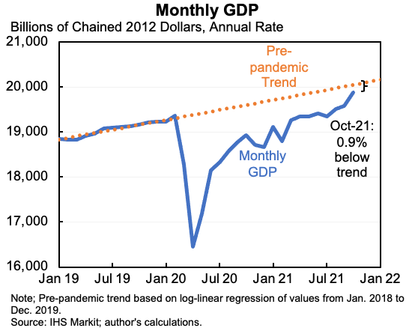
US GDP has re-attained the pre-Covid level,
but not quite the pre-Covid trend.
Jason Furman, December 1, 2021

Slide 8
Will inflation accelerate in 2022, as it did in the 1970s?
Due to excessive expansion of demand? Probably not:
  The extraordinary fiscal & monetary stimulus of the first pandemic year
    were big enough to return US to pre-Covid GDP by mid-2021,
    but not above pre-Covid trend in GDP.
  Demand has re-attained pre-Covid trend. Supply has not. => inflation.
Will our policy-makers repeat the mistakes of 1967-72? No.
  Fiscal policy:
    LBJ & Nixon increased Vietnam-War-era spending, without paying for it.
    Biden’s social spending bill is paid for (by funding IRS & raising taxes).
  Monetary policy:
    Nixon & Burns lowered interest rates in 1971 & 72,
    while imposing wage-price controls to suppress inflation temporarily.
    Powell’s Fed, despite initially underestimating 2021 inflation, has started tapering
      & signaled an early increase in interest rates.

Slide 9
● 2. Return of EM debt crises?
  As in 1982, 1994, 1997-98, 2009, 2013, 2018?
  Current vulnerability from elevated Debt/GDP ratios.
  Possible triggers from global financial environment:
    Fed raises interest rates.
    Investors shift back to “risk-off”. (See VIX.)

Slide 10
Economic impact of Covid crisis, 2020-21, vs. Global Financial Crisis, 2009-10.
% of GDP
Covid-19
GFC
Covid-19 has
hit developing
countries harder.
Estimated by UNCTAD, Sept. 2021

Slide 11
EM debt is vulnerable
Governments were able to finance spending in the pandemic.
  Good.
But high Debt/GDP now leaves EMDEs vulnerable.
  Why, if interest payments are low?
  Because debt sustainability is vulnerable to a rise in interest rates,
    whether from US interest rates,
    local risk premia,
    or both.
  It is already happening.

Slide 12
EMDEs were able to run larger deficits in 2020,
though not as large as AEs.
Overall Fiscal Balance
Venturi & Zunino,
Nov. 2021.
Fig.4, Panel A.
Data source: IMF Fiscal Monitor Database of Country Fiscal Measures in Response to the COVID-19 Pandemic.:

Slide 13
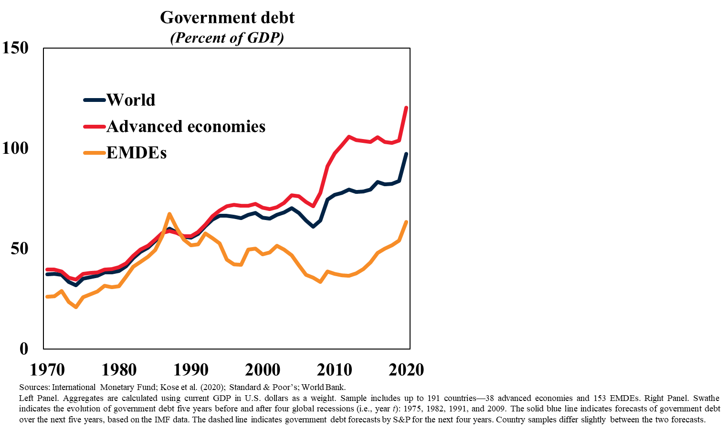
Government debt/GDP has risen sharply in the pandemic, in both AEs & EMDEs.
But investors tolerate,
levels of debt in the US
that they do not in EMDEs.
Credit-rating agencies have downgraded sovereign debt in more than 25 EMs.
M. Ayhan Kose,
World Bank, Sept.2021

Slide 14
Further downside risks to the global outlook:
3. Some other event, like the US hitting a debt-ceiling cliff,
could burst the “everything bubble.” Besides EM assets,
  Stocks
  Bonds
  The bubbliest assets: Meme stocks, SPACs, Cryptocurrencies, NFTs…
4. China could experience a financial crisis
  due to the longstanding problem of bad loans.
  In particular, in the housing sector. Evergrande.
5. Omicron.

Slide 15
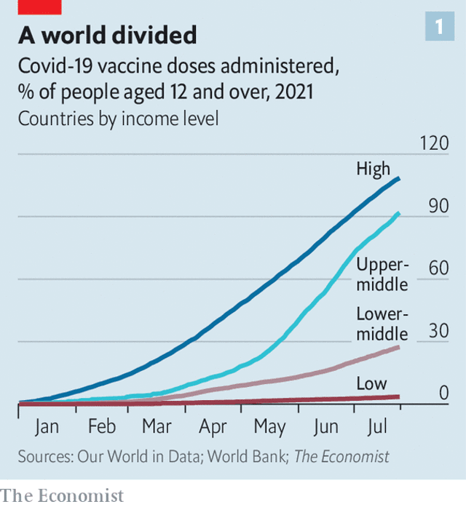
5. ● The world could lose the race between vaccination & more dangerous variants.
Vaccination in low-income
& lower-middle countries
lags far behind the rich.
So long as this coronavirus runs wild anywhere, it is a danger
to everyone everywhere.
As the Omicron variant has
now demonstrated anew.
The Economist, July 31, 2021.
“The pandemic has exacerbated existing political discontent”
www.economist.com/international/2021/07/31/the-pandemic-has-exacerbated-existing-political-discontent

Slide 16


Omicron could prove to be a severe adverse supply shock.
AS shifts left. => the worst of both worlds: GDP↓ & inflation↑. That would be stagflation.
AS _{new}
p
AS _{initial}
•
AD
|
$$\overline{y}´$$
|
$$\overline{y}$$
y

Slide 17
But in the 2020 recession,
Aggregate Demand initially fell as much as Aggregate Supply.
<= Inflation didn’t change much in 2020.
AS_{pandemic}
p
AS₂₀₁₉
•
2021
•
•
2020
2019
AD ₂₀₂₁
AD₂₀₁₉
AD ₂₀₂₀
y
Fiscal & monetary stimulus => AD back to right in 2021.

Slide 18
Stagflation?
Jeffrey Frankel
https://scholar.harvard.edu/frankel

Slide 19
Appendix graphs
1. Global GDP vs. long-run trend.
2. Advanced economies recovered from
the sharp 2020 recession more rapidly
    than in the past
    and than EMDEs.
3. Rising Debt/GDP ratios.
4. VIX, measure of market risk perceptions.
5. IMF growth forecasts.
6. The CEA argues 2021 inflation is most like 1946-48.

Slide 20
UNCTAD Trade & Development Report, Sept. 2021
1. Global GDP in 2021 Q2 surpassed its pre-pandemic level.
but is still 3 % lower than projected before the pandemic.*
}
* OECD estimate,
Dec. 2021

Slide 21
2. Recovery after the pandemic:
AEs with rapid vaccination recovered faster.
Ayhan Kose,
World Bank
Sept. 2021
Countries exceeding pre-recession peak after two years
(Percent of countries)
Forecast revisions in 2021,
by vaccination progress
(Percentage points)
COVID-19 cases and vaccine doses, July to August
(Percent of population)
Sources: Bolt et al. (2018); Kose, Sugawara, and Terrones (2020); Our World in Data; World Bank.
Left Panel. The share of economies in which per capita income levels after two years of global recessions are above the pre-recession peaks. Bar for past global recessions shows an average share during the five previous global recessions: 1945-46, 1975, 1982, 1991, and 2009 global recessions. Center Panel. Figure shows 2020 GDP-weighted forecast revisions for countries above or below median vaccination progress in each aggregate, based on the total number of people that received at least one dose of COVID-19 vaccine per 100 people. The vaccination measure is used as a daily average over June to August (up to August 22). Sample includes 36 advanced economies and 147 EMDEs. Right Panel. Figure shows the one-month accumulation of COVID-19 cases in advanced economies and EMDEs over July 5 – August 1, as estimated by the Institute for Health Metrics and Evaluation (IHME), and vaccinations as a share of the population.

Slide 22
3. EMDE Debt/GDP ratios rose in 2020.
They rose more in AEs.
But investors tolerate, levels of debt in the US,
that they do not in EMDEs.
General Government Gross Debt / GDP
Credit-rating agencies have now downgraded sovereign debt in more than 25 EMs.
Venturi & Zunino, Nov. 2021, Fig.5.
Data source: IMF Fiscal Monitor, Oct. 2021

Slide 23
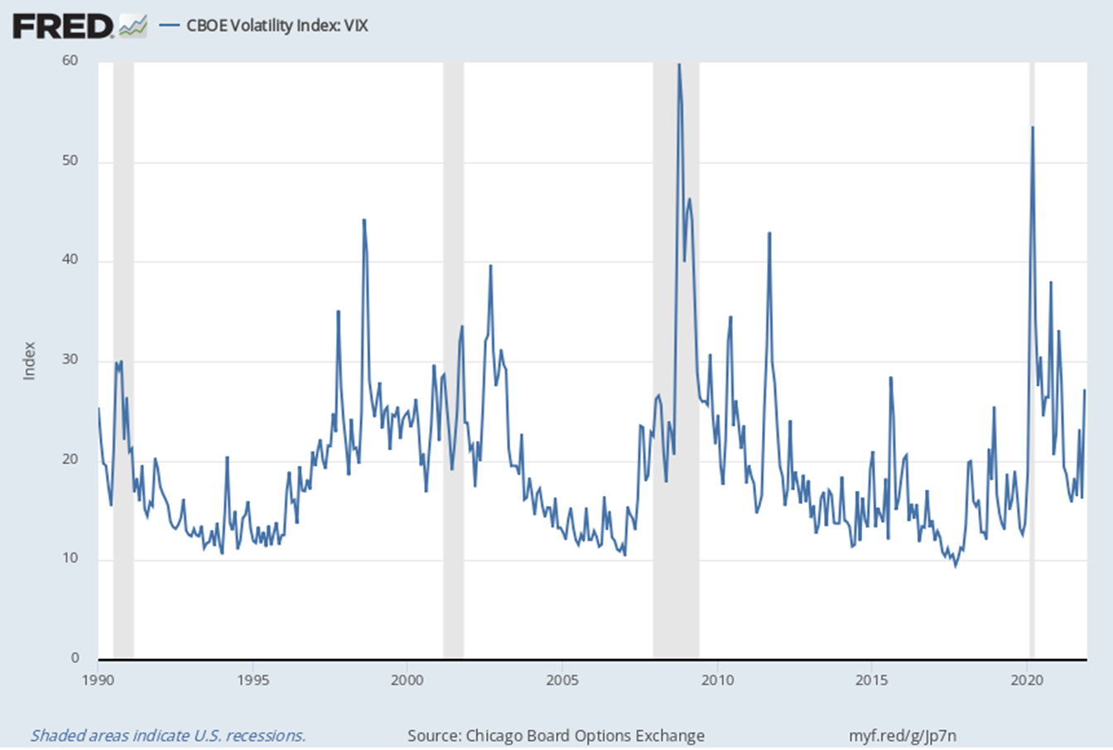
4. VIX, 1990-2021
Perceived risk rose in November,
but is well below the GFC & Coronavirus peaks.
Oct. 2008
(GFC): 60
March 2020: 54
Nov.30: 27

Slide 24
5. IMF WEO GDP growth forecasts (Oct. 2021).
The IMF sees 5.9% in 2021, 4.9% in 2022 (vs 3.3% 2016-19).

Slide 25
India & Latin America were hit hardest by the pandemic.
WEO GDP growth forecasts (Oct. 2021), continued

Slide 26
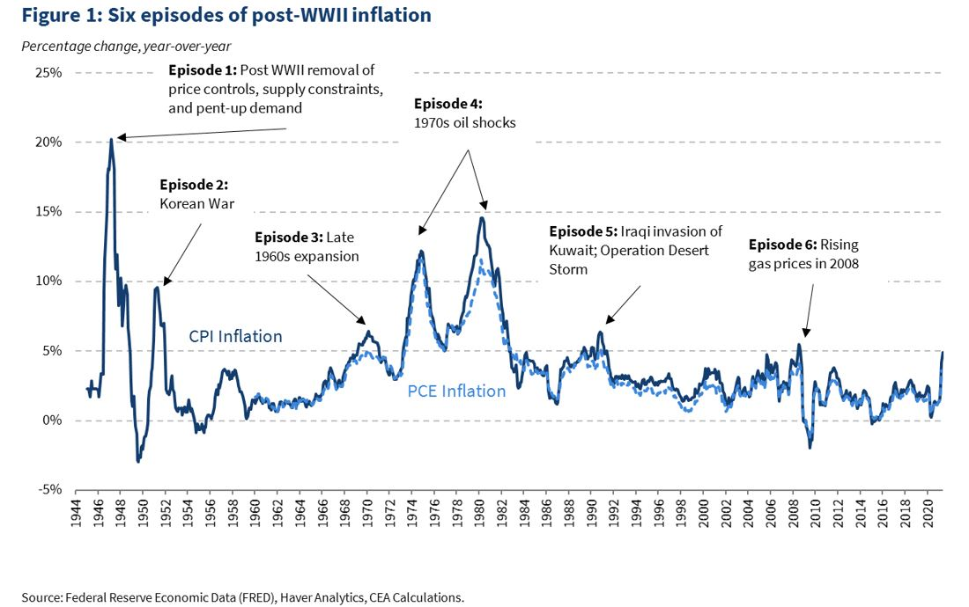
6. The CEA argues 2021 inflation is most like 1946-48.
“Historical Parallels to Today’s Inflationary Episode,” Council of Economic Advisers, JULY 06, 2021

