Slide 1

Trump’s tariffs:
Taking a sledgehammer to US global leadership
Jeffrey Frankel
James W. Harpel Professor of Capital Formation and Growth
Boston Committee on Foreign Relations
May 13, 2025

Slide 2
Tariffs & the trade deficit
The decline of manufacturing jobs
The end of US global leadership

Slide 3
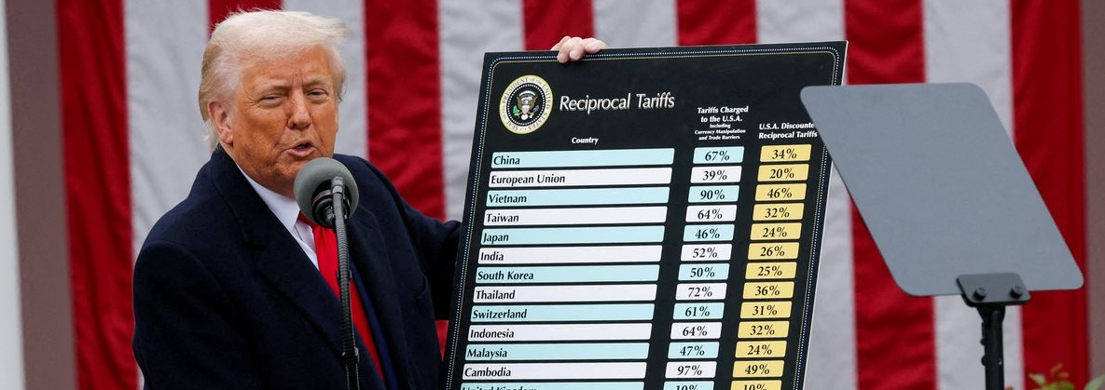
1. On April 2, Trump announced long-awaited “reciprocal tariffs”
The computations were based, not on other countries’ tariffs against US,
but rather on bilateral merchandise trade balances.
Makes no sense.

Slide 4

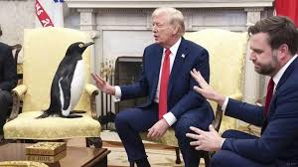
The tariff targets included Heard & MacDonald Islands
which refused to be intimidated.

Slide 5
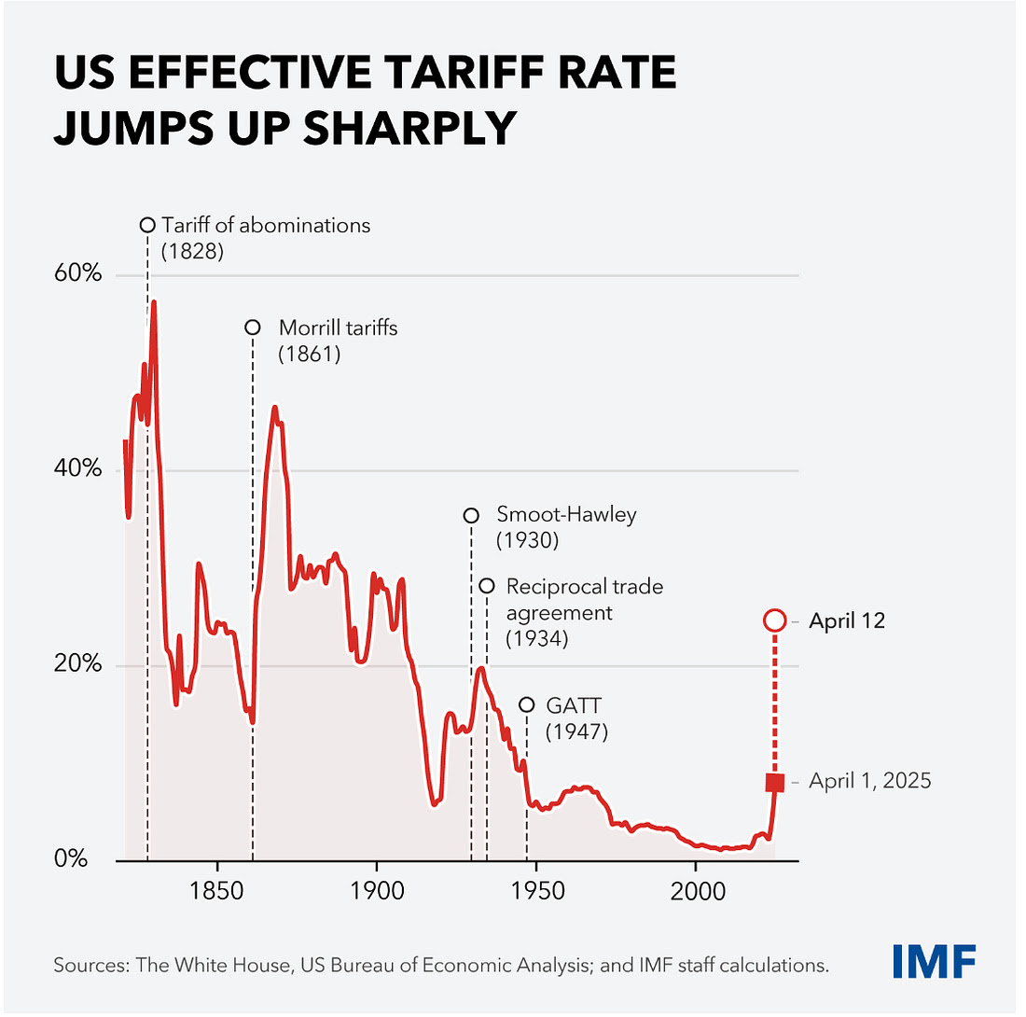
As of April 12, Trump’s tariffs exceeded Smoot-Hawley

Slide 6
Economic damage to US
Cost of living for households ↑
Costs of imported inputs for firms ↑
US exports ↓
  via slowed income abroad,
  $ appreciation
    (now overwhelmed by effects of uncertainty & Trump attacks on Fed independence )
  & retaliation. Like Smoot-Hawley.
Economic damage to other countries
Loss of US demand for their exports
Costs to them of their own retaliation against imports from US
  Cost of living ↑
  Input costs ↑
  Further reduction in their exports…

Slide 7
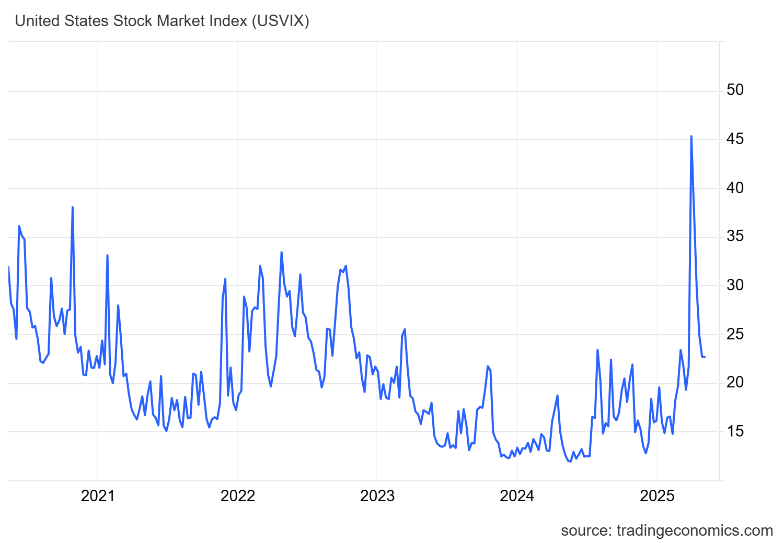
Tariff uncertainty may have worse effects than the actual tariffs
April 2025 tariff antics spiked risk perceptions
Volatility Index for US Stock Market (USVIX) May 2020-April 2025
https://tradingeconomics.com/vix:ind

Slide 8
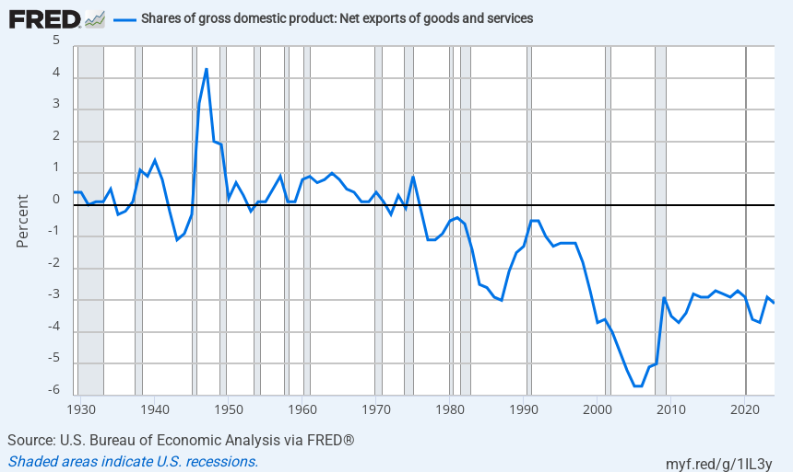
It is true that the US trade deficit has gotten worse
US trade balance / GDP 1929-2024
https://fred.stlouisfed.org/series/A019RE1A156NBEA
Notes:
Source:
U.S. Bureau of Economic Analysis
Release:
Gross Domestic Product
Units:
Percent, Not Seasonally Adjusted
Frequency:
Annual
BEA Account Code: A019REFor more information about this series, please see http://www.bea.gov/national/.
U.S. Bureau of Economic Analysis,
Shares of gross domestic product: Net exports of goods and services [A019RE1A156NBEA],
retrieved from FRED,
Federal Reserve Bank of St. Louis;
https://fred.stlouisfed.org/series/A019RE1A156NBEA,
May 9, 2025.

Slide 9
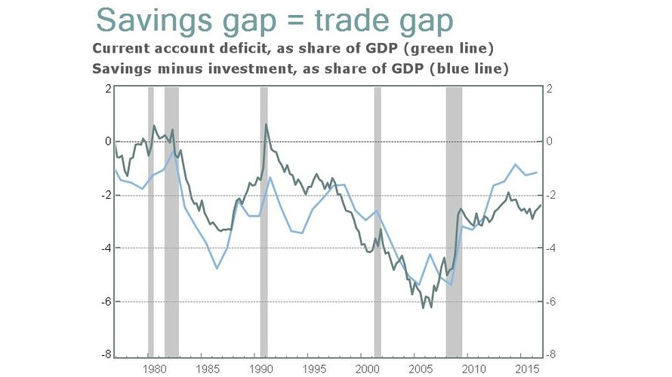
Trade deficits are determined by macroeconomics, not tariffs
The US current account <0
<= S is not big enough to fully offset BD
Also because of $ “exorbitant privilege”
National savings gap = trade gap
=> They “subsidize” us.
www.marketwatch.com/story/what-trump-doesnt-get-about-the-link-between-us-savings-and-trade-deficits-2017-04-21

Slide 10
What does the classical case for free trade leave out?
Monopoly power among nations (=> “optimal tariff”)
Imperfect competition among firms (“new trade theory”)
Distribution of income (e.g., trade may hurt unskilled labor in US)
National security (e.g., dependence on imported drugs or PPE)
Spillover gains in some particular industry
  Infant industry
  Protection of declining industries
  But you can’t subsidize everything.
  Is manufacturing the key?

Slide 11
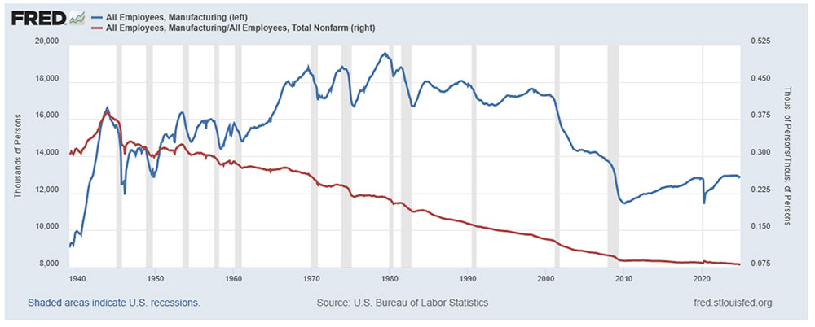
2. It is true that US manufacturing employment has declined, from 39 % of total employment in 1939, to 8 % in 2024.
share
https://blog.uwsp.edu/cps/2025/01/29/u-s-manufacturing-employment-a-long-term-perspective/

Slide 12
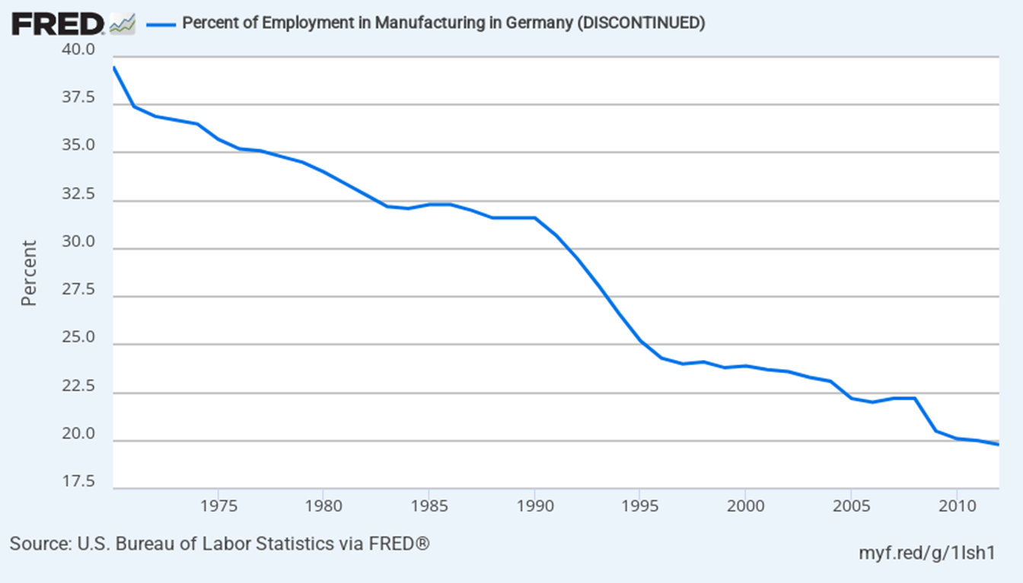
2. Is the decline in US manufacturing jobs due to trade deficits?
No, the same holds in Germany & Japan, who run trade surpluses.
https://fred.stlouisfed.org/series/DEUPEFANA
Notes:
Source:
Board of Governors of the Federal Reserve System (US)
Release:
H.15 Selected Interest Rates
Units:
Percent, Not Seasonally Adjusted
Frequency:
Daily
Discount BasisFor questions on the data, please contact the data source. For questions on FRED functionality, please contact us here.
Board of Governors of the Federal Reserve System (US),
1-Year Treasury Bill Secondary Market Rate, Discount Basis [DTB1YR],
retrieved from FRED,
Federal Reserve Bank of St. Louis;
https://fred.stlouisfed.org/series/DTB1YR,
April 11, 2025.

Slide 14
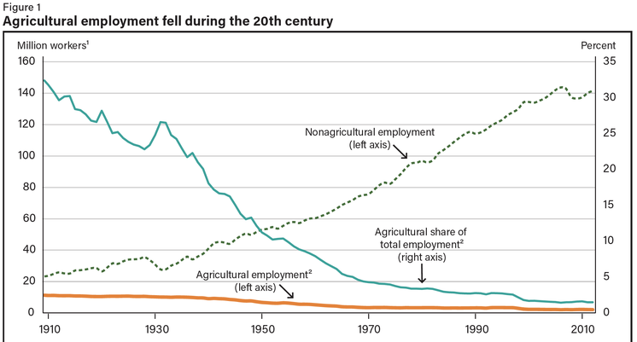
Analogously, US farm jobs fell from 90% in 1790 to 2% today.
We should celebrate productivity gains in agriculture & manufacturing,
shouldn’t wish to go back to the backbreaking jobs of the past.

Slide 15
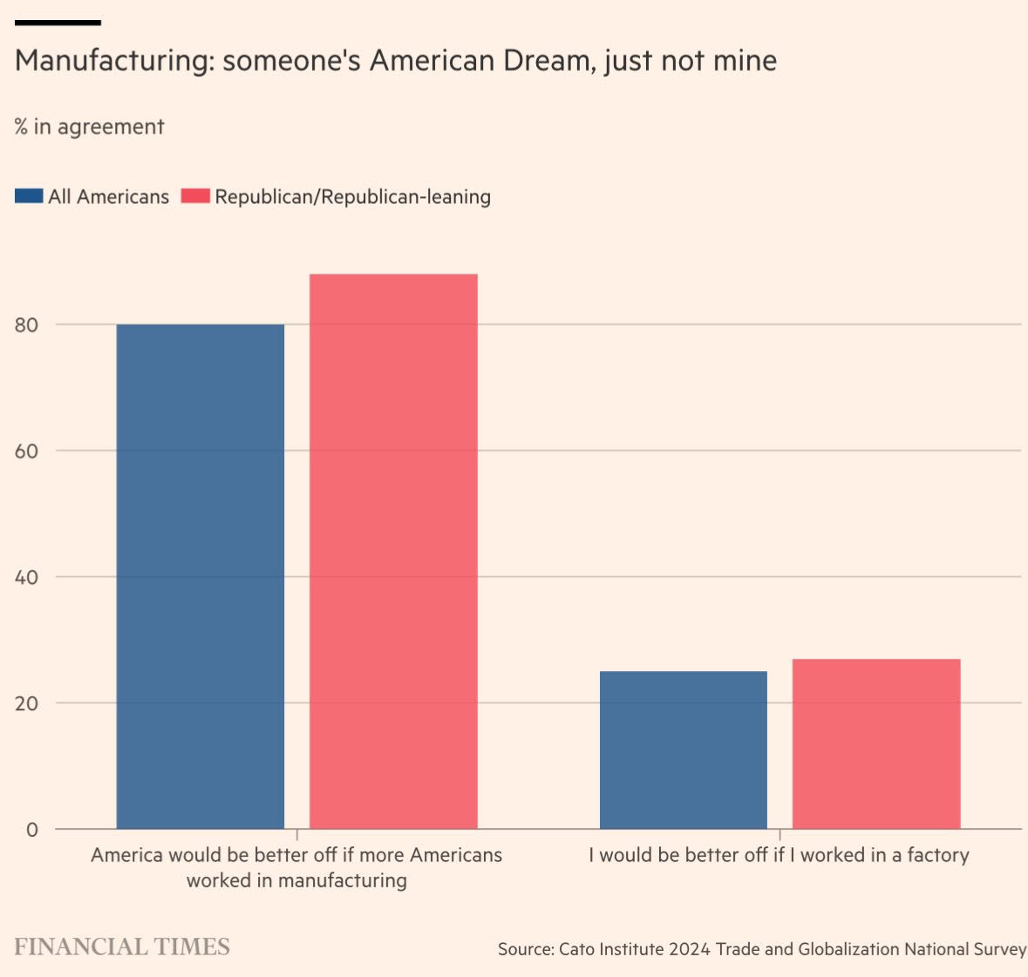
Why do voters yearn for return to manufacturing?
I don’t know. Maybe nostalgia.
They don’t want the jobs for themselves.
FT, April 14, 2025 www.ft.com/content/845917ed-41a5-449f-946f-70263adbaeb7
Notes:
Source:
Board of Governors of the Federal Reserve System (US)
Release:
H.15 Selected Interest Rates
Units:
Percent, Not Seasonally Adjusted
Frequency:
Daily
Discount BasisFor questions on the data, please contact the data source. For questions on FRED functionality, please contact us here.
Board of Governors of the Federal Reserve System (US),
1-Year Treasury Bill Secondary Market Rate, Discount Basis [DTB1YR],
retrieved from FRED,
Federal Reserve Bank of St. Louis;
https://fred.stlouisfed.org/series/DTB1YR,
April 11, 2025.

Slide 16
3. A rules-based global system, 1945-2024
Trump has violated US obligations
of the GATT, WTO, & even USMCA.
These rules were written under US leadership.
And for good reasons --
  Economic: everyone is better off agreeing & abiding by multilateral commitments by governments not to intervene in trade.
  Also geopolitical…

Slide 17
Some IR history
1801-1916: US isolationism avoided “entangling alliances”
1916 America First: Woodrow Wilson, “He kept us out of war.”
1917 Germany resumed U-boat attacks on US ships => US enters WWI.
1919 return to isolationism, protectionism
1940 FDR: "Your boys are not going to be sent into any foreign wars.”
1941 Pearl Harbor => US enters WWII.
1945: US determined not to repeat mistakes of isolationism & protectionism
Multilateral system of rules & institutions (GATT, IMF, IBRD, WTO…)
=> trade/GDP ↑ (see graph),
  under US leadership,
  80 years of unprecedented peace & prosperity
  US “soft power” won the Cold War (Joe Nye).
  Now we are throwing it all away, ceding the field to China.

Slide 18
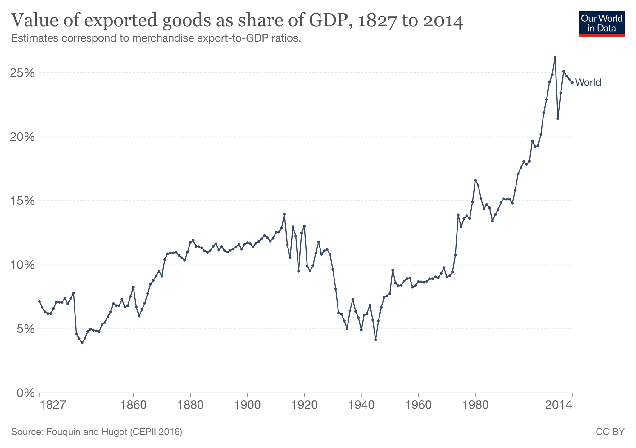
World trade/GDP rose in 1945-2008.
Liberalization:
1945-2008
Inter-war
period:
1914-45
1st Age of Globalization: 1840-1914
Data: Our World in Data
Doug Irwin, 2020

Slide 19
Trump’s tariffs violate international agreements
Especially the GATT & WTO.
And his own first-term agreement with Mexico & Canada:
  In Dec. 2019, he induced the neighbors to scrap NAFTA (which he had called a “nightmare” & “the worst trade deal ever made”)
  and to replace it with the USMCA. (“The largest, fairest, most balanced trade agreement ever achieved; there has never been anything like it.”)
The 25 % tariffs (still there) were not even part of his campaign.
Far from abiding by trade commitments with Canada & Mexico,
he has threatened military force against them!

Slide 20
One would expect the rule of law to bind even more domestically
Even for those “America Firsters” who disdain international responsibilities and free trade,
an American president should still abide by
American norms and laws.
These tariffs do not. The Constitution
gave Congress responsibility over trade policy.
The White House can’t justify these tariffs
by declaring a national emergency.

Slide 21
What is Trump’s plan?
Staking out a bargaining position to negotiate
a favorable “deal”?
  “Transactional”?
  Sacrificing long-term objectives like ethics, US reputation, & preservation of the system, to get concrete deals?
  But where are the deals?
Fits best: he likes non-zero “bespoke” tariffs so that US CEOs & foreign leaders will come to him as supplicants.

Slide 22
Appendix: Factors could trigger a US recession in 2025-28
the trade war,
the blocking of net immigration
US stock market crash.
Chaotic DOGE cuts
US fiscal crisis (bond market crash),
  from shutdown, debt limit, or credit downgrading
Uncertainty & risk => firms stop investment & hiring.

Slide 23
Trump’s tariffs:
Taking a sledgehammer to US global leadership
Jeffrey Frankel

Slide 24
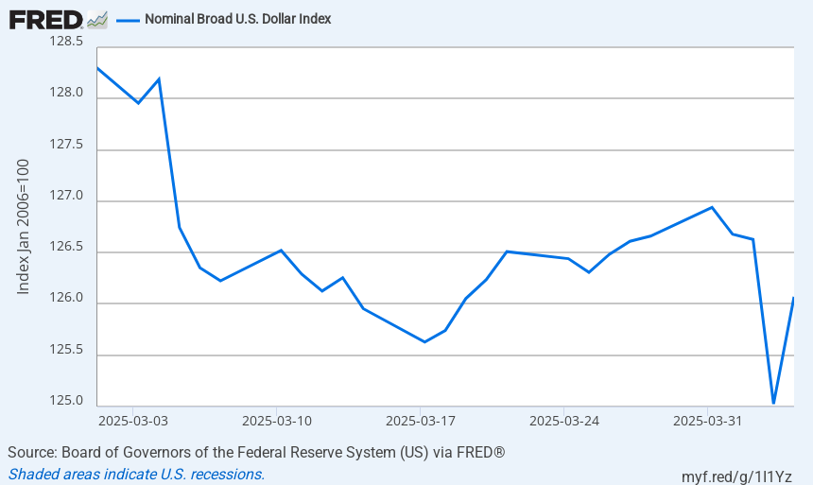
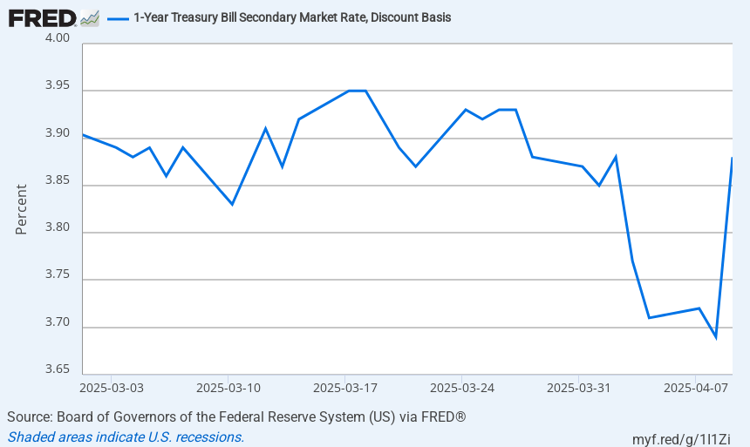
Safe haven no more? The dollar & T bill rate both fell on April 3, 2025
https://fred.stlouisfed.org/graph/?id=DTWEXBGS
https://fred.stlouisfed.org/series/DTB1YR

