Slide 1
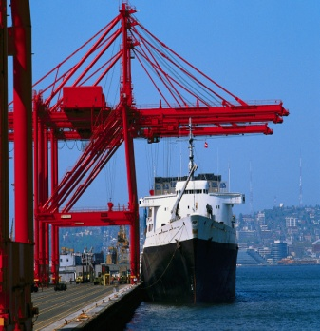
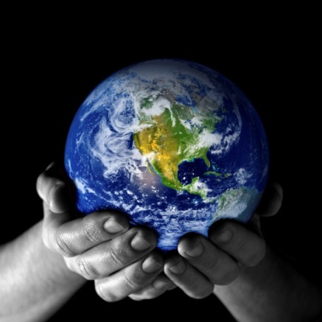

Trade, Growth, and the Environment
Jeffrey Frankel
Guest lecture: Rob Stavins class in
Environmental & Resource Economics and Policy
April 24, 2019
Notes:
1

Slide 2
Central question:
Is trade good or bad for the environment?
More specifically, is trade good or bad for
the environment for a given level of GDP?

Slide 3
Outline:
1. The trade-off between GDP & environmental goals.
-- Is there an Environmental Kuznets Curve?
2. Effects of trade on the environment:
  Harmful
  vs. Beneficial
3. Which effects tend to dominate in practice?
  Correlations. For SO2 & CO2.
  OLS estimates of effect of trade per se.
  Conclusion: Domestic vs. global externalities.

Slide 4
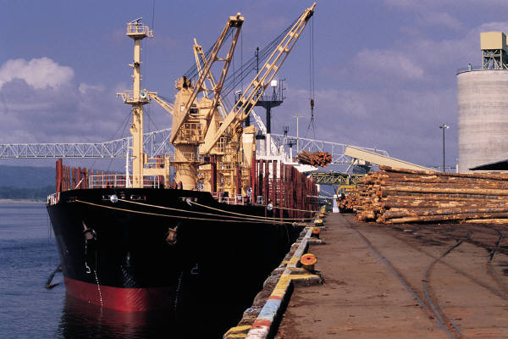
Widely agreed: trade is good for economic growth
1. Trade-off between GDP & environment
In theory:
-- Classical comparative advantage (e.g., Ricardo)
-- & modern theories of trade based
on imperfect competition (e.g., Krugman).
Empirically:
Econometric studies.
  One estimate: every .01 increase in a country’s trade/GDP ratio raises income 3 ½ % (over next 20 yrs.).

Slide 5


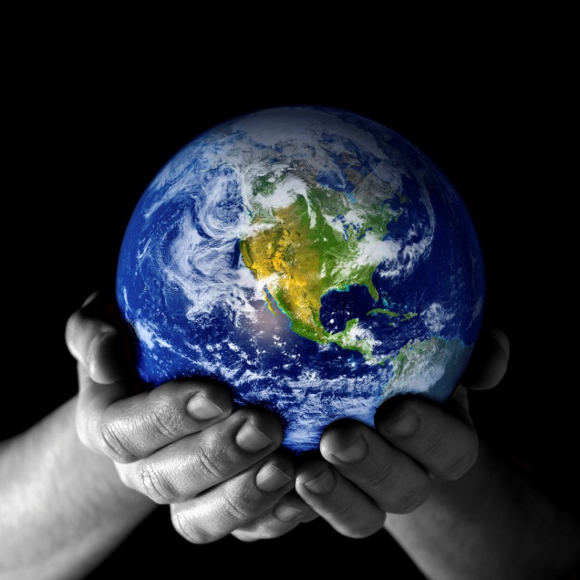
But what about effects of openness on environmental quality, which is not captured in GDP statistics?

Slide 6
We care about both environmental quality and (market-measured) real income.
•
Environmental damage ↑
•
Income per capita →
The objective, as always in economics:
to attain the best “indifference curve” or “iso-welfare” curve possible, subject to physical constraints.
But environmental externalities are the classic case where
the free market will not deliver the optimal tradeoff point.
  Such market failure calls for government intervention.
  Government regulation, if optimally designed, can deliver
  the optimum point (e.g., taxing pollution).

Slide 7
Is growth per se good or bad for the environment in practice?
Environmental damage
Income/capita
Environmental
Kuznets Curve: Grossman & Krueger (1995)
“Economic growth (whether trade-led or not) can improve
the environment above a peak level of income.”
  EKC is confirmed for some pollution measures, e.g., SO₂,
  but rejected for some others, especially CO₂ .

Slide 8
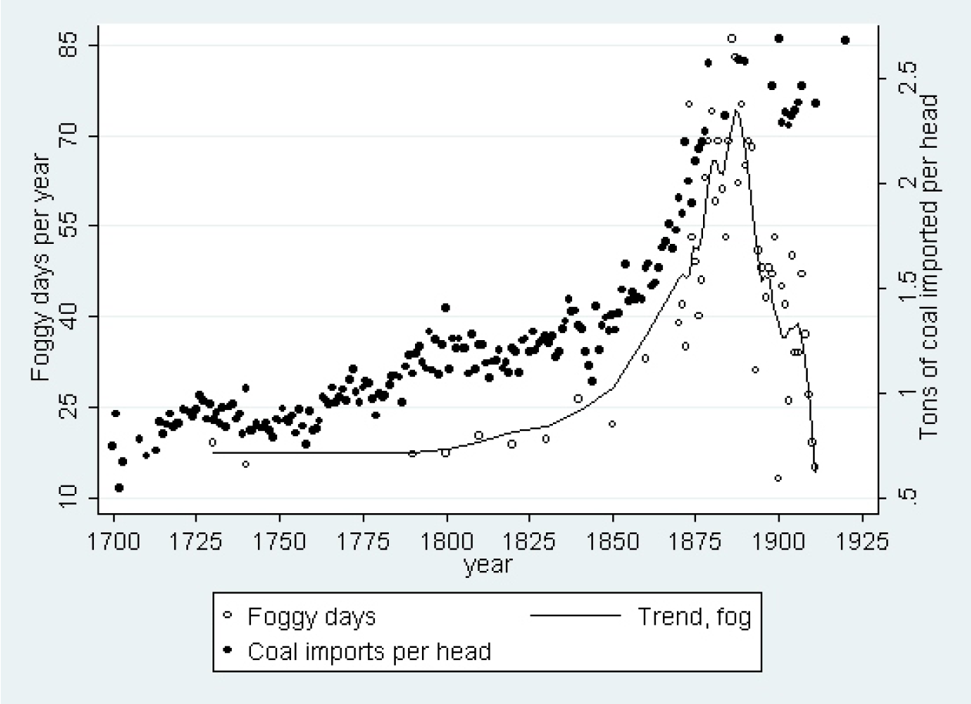
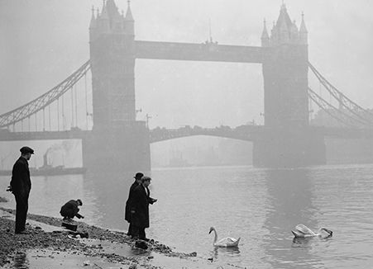
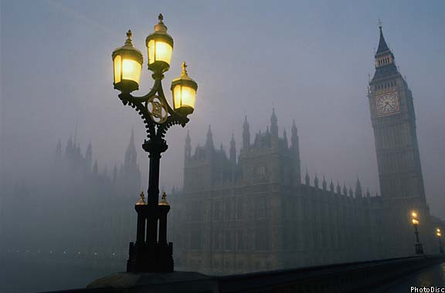
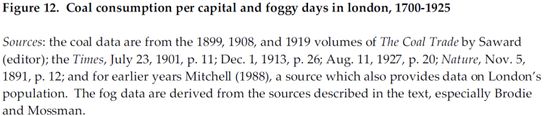
The first EKC: The London Fog (1700-1910),
i.e., coal smoke, peaked before 1900.
(though “killer fogs”
continued to 1952).)
Karen Clay & Werner Troesken, 2011, "Did Frederick Brodie Discover the World's First Environmental Kuznets Curve? Coal Smoke and the Rise and Fall of the London Fog,“ in The Economics of Climate Change: Adaptations Past and Present, Libecap & Steckel. Also http://www.air-quality.org.uk/03.php.

Slide 9
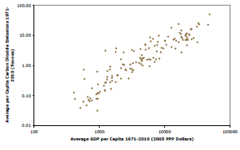
But no sign of an EKC in CO₂ emissions
Average per cap CO₂ emissions,
1971-2010 (in tonnes)
Average GDP/capita, 1971-2010 (in 2005 PPP dollars)
David I. Stern, “The environmental Kuznets curve after 25 years,” Journal of Bioeconomics, 2017.

Slide 10
2. Effects of trade on the environment
There are many possible effects.
They can be categorized
  according to whether they:
    (i) operate via GDP, analogously to investment, technology & other sources of economic growth,
    or (ii) are peculiar to trade alone,
    and hold for a given level of GDP.
  Within each category, there are effects both
    beneficial for the environment,
    and detrimental.
Notes:
10

Slide 11
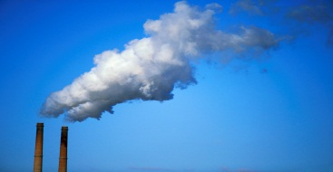

Is trade itself good or bad for the environment, in theory?
Environmental effects of trade | via growth in income: | for a given level of income :
 | Environmental K.Curve
Harmful effects | larger scale of economic activity; | “Race to the bottom” in national regulation;
Beneficial effects | shifts to cleaner techniques and composition of economic activity. | “Gains from trade”: e.g., trade in green goods…

Slide 12
The feared “race to the bottom”
Environmental regulation raises the cost of doing business.
Industry & labor worry about international competition.
The more open is a country to trade, the more pressure will
they exert on their government to reduce regulatory burden.
E.g., Barrett (1994).
There are also fears that trade will
affect the allocation of pollution across countries
The “pollution haven” hypothesis:
trade encourages some countries to specialize in producing dirtier goods:
  poorer countries
  more capital-intensive countries
  or less densely populated countries.
E.g., Levinson & Taylor (2004).

Slide 13
Some examples of trade helping environment
Imports of environmentally friendly products
  US ended 1980s tariffs & quotas on fuel-efficient Japanese autos, benefiting both consumer pocketbooks & air quality.
  Imports of cheap solar panels from China, 2010-17,
  lowered cost of solar power in US.
Trade brings technological innovation,
which can, for example, save energy.
Multilateral agreements
  Potential for trade sanctions,
  as in Montreal Protocol on stratospheric ozone depletion.
  The Trans-Pacific Partnership (TPP).

Slide 14
  The Trans-Pacific Partnership (TPP)
Most enviro NGOs opposed TPP from the beginning.
Did they read its enviro chapter when released in 2015?
It had, e.g., steps to:
1) protect ocean environment from ship pollution;
2) limit subsidies for fishing fleets
  which waste taxpayer money in pursuit of overfishing our oceans;
  3) implement bans on trade in endangered wildlife
  insufficiently enforced under CITES,
  4) & crack down on illegal logging.
For the first time in a regional agreement, these provisions were to be subject to a dispute settlement process
  backed up by the threat of economic penalties.

Slide 15

Economic/environmental win-win ideas
A global ban on subsidies to fossil fuels:
  It would achieve both enviro goal of cutting carbon emissions and economists’ goals of cutting deficit spending & economic distortion.
Remove tariffs/quotas on environmental goods imports
  The US could let in imports of Brazilian sugar/ethanol.
  WTO negotiations: liberalize environmental goods trade.
    14 countries decided in 2014 to pursue it plurilaterally.

Slide 16
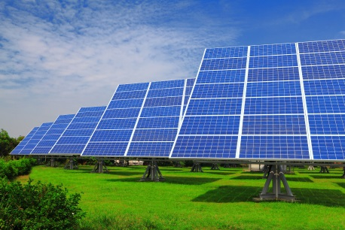
  More economic/environmental win-win ideas, continued
Reform unilateral “trade remedies” which
currently block imports of green goods.
  “Next Generation” cases (Wu, 2014):
    Anti-Dumping & -Subsidy actions.
Free up trade in renewable-energy inputs.
  Almost ¾ of EU trade-remedy barriers target
  imports of products used for renewable energy!
    Kasteng (2013).
  AD remedies currently block trade in solar power inputs:
    US has AD tariffs on imports of Chinese solar panels (2012, 2014).
      Trump added high “safeguard” tariffs against solar panels (Jan. 2018).
    China has them against imports of US polysilicon (2012);
    EU has penalties on imports of Chinese solar glass & panels (2013).
    They should be dropped, whether by negotiation or unilaterally.

Slide 17
3. Which tend to dominate in practice:
The effects of trade that are detrimental to the environment (e.g., race to the bottom)?
Or the effects of trade that are beneficial (e.g., US imports of solar panels)?
It depends on what measure of environmental quality is at stake.

Slide 18
SO₂ concentrations tend to fall with openness, especially after controlling for democracy, cross-country
SO₂
  Democracy matters too =>
  need effective national regulation,
  not just demand for clean environment.
Low-democracy
High-democracy
Openness = Trade/GDP

Slide 19
CO₂ emissions/cap tend, if anything, to rise with openness.

Slide 20
But these rough correlations tell us little.
To isolate the effect of trade on a country’s environment, we need to control for other determinants, such as
  income
  democracy
  population density.
Econometric analysis
  Antweiler, Copeland & Taylor (2001); Copeland & Taylor (2004, 05, 13)
  Frankel & Rose (2004); Frankel (2009).

Slide 21

Environmental quality equation
Source: Frankel & Rose, R.E.Stat., 2004
Environmental quality _{i} =
φ₀ + φ₁ ($\frac{GDP}{pop}$_{90, i} ) + φ₂ ($\frac{GDP}{pop}$_{90, i} )² + μ ($\frac{X+M}{GDP}$ _{90, i} )
+ π (Democracy _{90, i} ) + λ ($\frac{Land Area}{pop}$ _{90, i} ) + e _{i}
IV for GDP/cap: investment, education…
IV for openness: geographically-based prediction of trade

Slide 22
Is trade itself good or bad for the environment, statistically?
Source: Frankel & Rose (2004)
Environmental effects of trade | via growth in income: | for a given level of income:
for SO₂ concentrations | EKC: after an income of about $5,700/cap.1990, further growth tends to reduce pollution (via national regulation) | The favorable effects of trade seem to dominate.
for CO₂ emissions / capita | No sign that total emissions turn down. (CO₂ is a global externality: little regulation is possible at the national level.) | Trade may also increase emissions even for a given level of income.

Slide 23
Do harmful or beneficial effects of trade dominate for environmental goals? Bottom lines:
For SO₂
  at low incomes, harmful effects work against beneficial effects;
  at high levels of income, trade helps through both channels.
For CO₂
  Even at high levels of income, trade continues to hurt. <= Absent an effective multilateral treaty, the popular will cannot be enacted.

Slide 24
Summary of conclusions
Empirical studies of cross-country data find no harmful effects of trade on some environmental measures such as SO₂ air pollution, for given income.
So globalization & the environment need not conflict.
Trade & growth give countries means to clean the air,
    provided they have effective institutions of governance.
    For local pollution, the appropriate governance
    is at the national level.

Slide 25
Summary of conclusions, continued
But trade & growth can exacerbate other measures of environmental degradation: CO2 emissions.
The difference can be explained by the observation that CO2 is a global externality.
  It cannot be addressed at the national level
  due to the free rider problem.
  We need institutions of governance at the multilateral level.

Slide 26



The solution
Greater international cooperation
on environmental and trade issues,
to get the best of both.
One very specific example:
the UNFCCC or (better) the WTO should agree on guidelines for penalties on carbon-intensive
imports that countries are allowed
to impose on each other.

Slide 27


Slide 28




Writings underlying this lecture available at www.hks.harvard.edu/fs/jfrankel/GEI.htm
"Congress should approve TPP," Boston Globe, Nov. 11, 2015.
“Protectionist clouds darken sunny forecast for solar power,” VoxEU, 2013.
"Global Environment and Trade Policy,"
Post-Kyoto International Climate Policy, eds.
Joe Aldy & Rob Stavins; Cambridge Univ. Press, 2009.
“Environmental Effects of International Trade,”
A Report for the Swedish Globalisation Council,
2009. HKS RWP 09-006.
The Leakage/Competitiveness Issue In Climate Change Policy Proposals,” in Climate Change, Trade and Investment: Is a Collision Inevitable? (Brookings Institution Press), 2009,
Lael Brainard, ed. WCFIA WP 4792.
"Is Trade Good or Bad for the Environment?
Sorting out the Causality," with Andrew Rose,
Review of Economics & Statistics 87, no.1, 2005. NBER WP 9201

Slide 29
Appendices
Appendix 1: Anti-globalizers & the WTO
Appendix 2: Could trade measures be used in a climate change agreement?
Appendix 3: Frankel & Rose paper

Slide 30
Appendix 1:
Anti-globalizers and the WTO
The anti-globalization movement
Are WTO panel cases anti-environment?

Slide 31
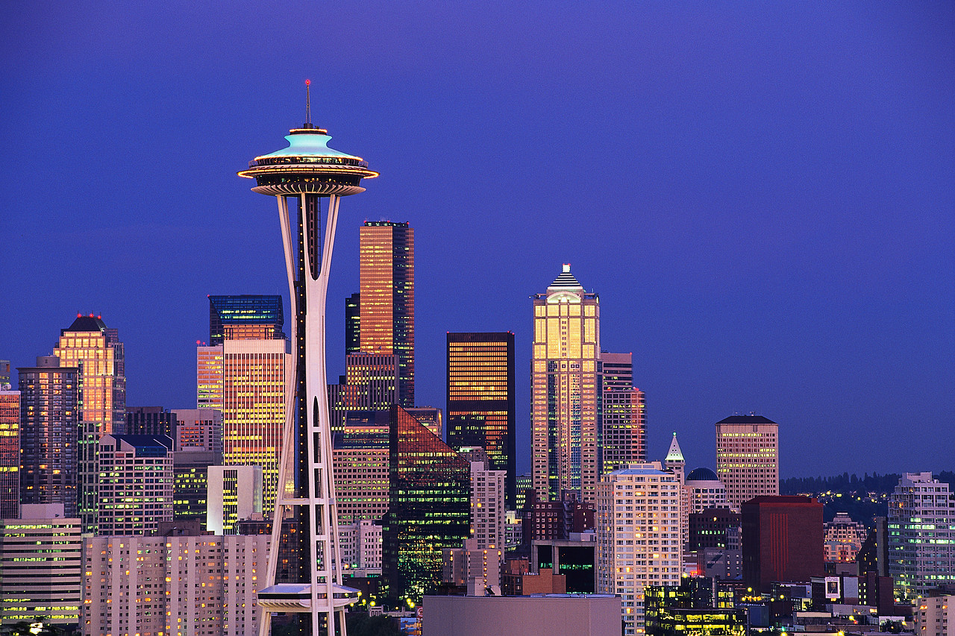
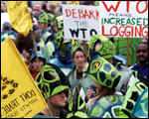
The anti-globalization movement: the first big protests in Seattle, 1999

Slide 32
The anti-globalization movement, continued
Some of the anti-globalization protestors at the 1999 Seattle WTO Ministerial meeting wore turtle costumes.
Why?
They felt that a WTO panel
had, in the name of free trade,
blocked the ability of the US
to protect Indian ocean sea
turtles from shrimpers.

Slide 33
The impossible trinity
of global environmental regulation
Protectionism
National sovereignty
Environmental
standards
RACE TO THE BOTTOM
An alter-native
Unregulated emissions
Multilateral
governance
Globalization

Slide 34
What do the anti-globalizers mean when they say the WTO is an intrusive undemocratic bureaucracy?
Its governance? = the member-country governments.
  Technically one-country one-vote.
  True, US & EU have disproportionate weight.
  But making it more democratic means giving more weight to India. Result: Policy gives lower priority to the environment.
The Articles of Agreement?
Hard to object to (next slide).
The WTO staff?
A few thousand powerless technocrats
working in a building on Lake Geneva.
WTO panel rulings that interpret the rules? That must be it.

Slide 35
WTO language supports the environment:
  Article XX allows exceptions for health & conservation.
  Preamble to 1995 Marrakesh Agreement establishing WTO seeks “to protect and preserve the environment;”
  2001 Doha Communiqué starting new round of negotiations: “the aims of ... open and non-discriminatory trading system, and acting
  for the protection of the environment ...
  must be mutually supportive.”

Slide 36
Typical WTO panel cases
Tariffs or other measures that discriminate against producers in some trading partners,
  either in favor of other trading partners
  (potential violation of MFN principle of Article I) or
  in favor of “like products” from domestic producers
  (potential violation of national treatment provision of Article III).

Slide 37
Typical WTO panel cases, continued
If a targeted country files a WTO complaint alleging such a violation, the question is whether the measure is permissible under Article XX
  which allows for exceptions to the non-discrimination principles for environmental reasons (XXb),
  provided that the measures in question are not
  “a means of arbitrary or unjustifiable discrimination” nor a “disguised restriction on international trade.”

Slide 38
Appendix 2:
Could trade measures be used in a climate change agreement?
Question (1):
GHG emissions are generated by so-called Processes and Production Methods (PPMs).
Does that rule out trade measures against them?
No; 3 precedents.
Question (2):
What specific trade control
design is appropriate?

Slide 39
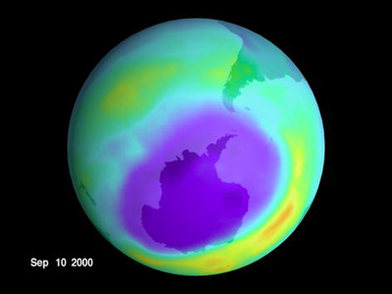
Precedent (1): Montreal Protocol on stratospheric ozone depletion
Trade controls had two motivations:
  (i) to encourage countries to join, and
  (ii) if major countries had remained outside, would have minimized leakage, the migration of production of banned substances to nonparticipating countries.
  In the event, (i) worked, so (ii) not needed.

Slide 40
Precedent (2): The true meaning of the 1998 WTO panel shrimp-turtle decision
New ruling: environmental measures can target,
not only exported products (Article XX), but also partners’ Processes & Production Methods (PPMs),
subject, as always, to non-discrimination (Articles I & III).
US was able to proceed to protect turtles, without discrimination against Asian fishermen.
Environmentalists failed to notice
or consolidate the PPM precedent.

Slide 41
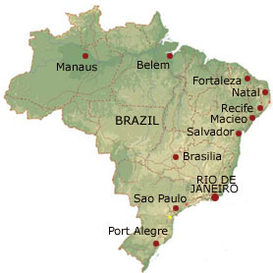
Precedent (3): In case there is any doubt that Article XX, which uses the phrase “health and conservation,” applies to climate change, …
a 3rd precedent is relevant:
In 2007, a WTO Appellate Body decision
regarding Brazil restrictions on imports of retreaded tires confirmed the applicability of Article XX(b):
Rulings “accord considerable flexibility to WTO Member governments when they take trade-restrictive measures to protect life or health…[and] apply equally to … measures taken to combat global warming.”

Slide 42
Although border measures to address leakage
need not violate trade principles or the WTO,
the big danger in practice is: If each country imposes border measures however suits national politics,
  they will be poorly targeted, discriminatory,
  and often disguisedly protectionist;
  they will run afoul of the WTO, and will deserve to.
A multilateral regime could guide such measures.
Some subjective judgments as to principles that should guide design of border measures….

Slide 43
What form should border measures take?
Best choice: multilateral penalties. (Not likely.)
Next-best: national sanctions
adopted under multilateral guidelines
    Penalties can only be applied by participants-in-good standing
    Judgments to be made by technical experts, not politicians
    Penalties only in 6 or 8 of the most relevant sectors (aluminum, steel,…).
Third-best choice: No border measures.
Each country chooses carbon tariffs as it sees fit.
Worst choice: national measures are subsidies
(e.g., free permits) to adversely affected firms.

Slide 44
Appendix 3: Frankel & Rose (2005)
Equations estimated:
  Growth equation
  (using gravity variable as IV for trade openness)
  Environmental quality equation
  (using factor endowments as IV for growth)

Slide 45
Construction of IV for openness
First-stage regression of gravity equation
log(Trade_{ij}/GDP_{i}) =
- .94 log(distance_{ij}) + .82 log(pop_{j}) + .53 Language_{ij}
(.05) (.02) (.11)
+ .64 Border_{ij} - .27 log(A_{i}A_{j}) - .47 # Landlocked_{ij} + u_{ij}
(.21) (.01) (.08)
Equation estimated for 1990.
Number of Obs. = 4052.
R2 = .28 (Robust standard errors in parentheses.)
Computation of Instrumental Variable
Take exponent of fitted values of bilateral trade and sum across bilateral trading partners: Σ_{j} exp [Fitted log(Trade_{ij}/GDP_{i}) ] .
Correlation (trade ratio, generated IV) = .72

Slide 46
Measures of environmental damage
SO2: sulphur dioxide, mean (in micograms per cubic meter), 1995
NO2: nitrogen dioxide, mean (in micograms per cubic meter), 1995
PM: Suspended Particulate Matter, mean total (in micograms per cubic meter), 1995
Water: Rural Access to Clean Water
Def: annual deforestation, average percentage change, 1990-95
Energy: Energy depletion, in percent of GDP (“genuine savings”)[1]
CO2/capita: Carbon dioxide emissions, industrial, in metric tons/cap
[1] Energy depletion is a measure computed for the World Bank’s World Development Indicators. It is equal to the product of unit resource rents and the physical quantities of fossil fuel energy extracted (including coal, crude oil, and natural gas). Table 3.15, http://www.worldbank.org/data/wdi2001/pdfs/tab3_15.pdf.

Slide 47
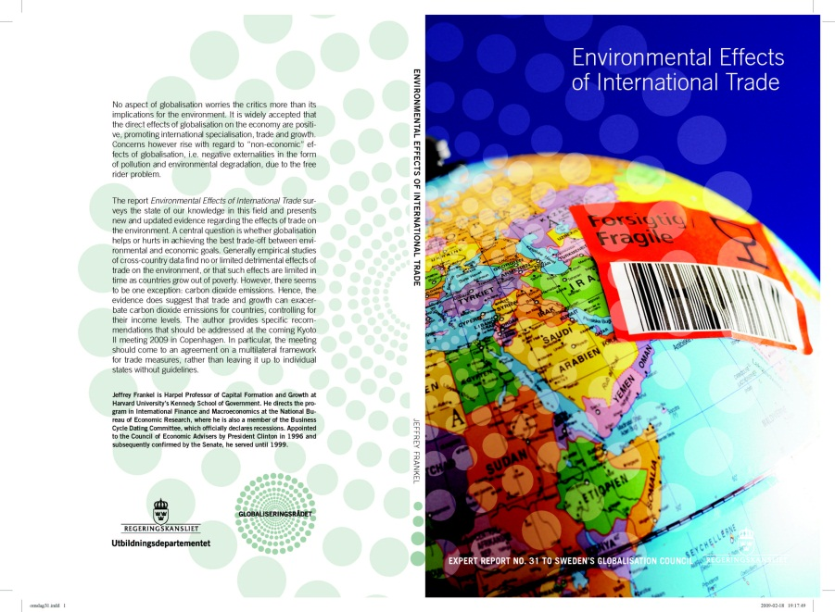
I updated the Frankel-Rose econometric analysis
in a 2009 paper for the Swedish Globalisation Council
-- putting together data for 1990-2004,
  -- for 158 countries.
EKC (inverted U) shows up
for PM10 and water pollution.
Trade still appears to worsen CO₂.
Again, the obvious explanation:
lack of a comprehensive global climate agreement.

Slide 48

The author acknowledges
valuable input from Joseph Aldy, Scott Barrett, Jagdish Bhagwati, Thomas Brewer, Steve Charnovitz, Arik Levinsohn, Gary Sampson & Robert Stavins;
and support from
  the Harvard Program on International Climate Agreements
  a Faculty Grant in Sustainability Science
  from Harvard’s Center for International Development,
  as well as from the Government of Sweden.

