Slide 1

Trade and Inequality
Jeffrey Frankel
Harpel Professor of Capital Formation & Growth
Harvard University
Providence Committee on Foreign Relations
December 14, 2016
An earlier version was presented as the Clair Wilcox Lecture, Swarthmore College, Oct. 24, 2016

Slide 2
Overview on Trade & Inequality
The connection between trade and inequality received intense interest in this strange presidential election year.
  Why did Trump’s success catch elites so much by surprise?
  The story: “we hadn’t adequately realized how deep was the hardship and anger of those left behind by globalization… “
  “Trade led to inequality, and inequality led to Trump. “
  Analogous stories in Europe, e.g., Brexit.
I will talk
  first about trade,
  then about inequality & its causes.

Slide 3

Trade & GDP
Widely agreed: trade is good for economic growth.
Theory:
from David Ricardo to Paul Krugman,
says that trade allows real income
to grow via specialization.
Empirically: many econometric studies.
  E.g., one estimate: every .01 increase in a country’s trade/GDP ratio raises income 3 ½ % (over next 20 years).
Most Americans seem to agree:
  Polls show surprisingly high support for trade.
What about effects of trade on other objectives? Inequality? ->

Slide 4
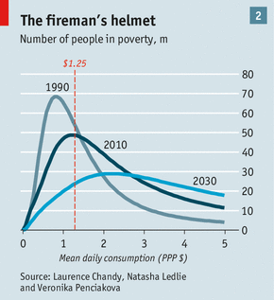
Trade has helped shift global income distribution upward.
The Economist, June 2013, The world has an astonishing chance to take a billion people out of extreme poverty by 2030
//www.economist.com/news/briefing/21578643-world-has-astonishing-chance-take-billion-people-out-extreme-poverty-2030-not

Slide 5
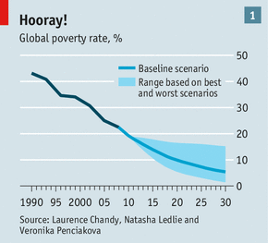
Global poverty has been cut more than ½ in the last 25 years
In 1990, 43% of the population of developing countries lived in extreme poverty (then defined as $1 a day) = 1.9 billion people.
By 2010 it was down to 21% = 1.2 billion.
The Economist, June 2013, The world has an astonishing chance to take a billion people out of extreme poverty by 2030
//www.economist.com/news/briefing/21578643-world-has-astonishing-chance-take-billion-people-out-extreme-poverty-2030-not

Slide 6
Inequality & anti-globalization
  Elections are domestic, of course.
  Typical explanation for the surprise Trump nomination:
  Globalization
  US inequality.
  Anger from those left behind
  who then support radical changes.
  “We should have seen it coming, but were out of touch.”
To summarize my take:
  Inequality has unquestionably risen, esp. in US.
  Trade & immigration probably play small roles,
    along with a long list of other factors.
  I don’t see the inequality issue logically leading to Trump.
  There are some clear answers to the question: How can we address the wellbeing of workers who have been left behind?

Slide 7
Needless to say, trade creates both winners & losers.
So does every change.
  E.g., putting up tariffs would create both winners and losers (many).
“Pareto superiority” would require that everyone wins.
  If we economists require that before recommending one policy over another, then we can never make any recommendations. Someone always loses.
Economists can make win-win policy recommendations
if we express the distributional consideration in terms of
a desired measure of overall inequality.
  We can approve a policy that, while raising total income,
  also reduces measures of inequality,
  lowers the poverty rate,
  or raises median income.

Slide 8
Does trade worsen inequality?
The “Second Welfare Theorem of Economics” suggests
free trade increases the size of the pie by enough that the winners could compensate the losers, so that everyone comes out ahead, in theory.
But, we need to consider, first:
are the losers from trade concentrated in the lower segments of the income distribution?
A simple encapsulation includes three effects --
  (+) Consumption: the opportunity to import at lower prices
  and with greater variety works to raise real income for all.
  This helps lower-income families.
  (-) Imports tend to hurt those in import-competing sectors.
  (+) Those losses are offset by the gains for exporting sectors.
    Export jobs pay an estimate 18% more.

Slide 9

What about NAFTA? Didn’t it devastate workers?
No.
Listening to claims that NAFTA hurt American workers, one would never guess that the half-decade after it went into effect
  featured the most job creation in the last 40 years.
In 1996-2000 GDP growth averaged 4.3%,
  productivity growth = 2.5%
Unemployment < 4% by end-2000.
It’s the one period since the 1970s when
  lower-income workers shared fully in the gains:
    real compensation/hour rose 2.2%,
  median family income rose strongly:
    from $26,000 in 1993 to $35,000 in 2000 [in real $2002],
  and the poverty rate declined steadily
    from 33.1% in 1993 to 22.5% in 2000.
Needless to say, lots of factors underlay those achievements.

Slide 10

Recent research on job loss in import-competing sectors
David Autor, David Dorn & Gordon Hanson
(2013, 2016) have found evidence that
  a portion of lost US manufacturing jobs
  can indeed be associated with imports,
    especially from China.
  Employment & income in towns hit by such job losses can stay depressed for a much longer time than some had imagined.

Slide 11
Rising US inequality:
Since 1980, almost all gains have gone to people at the top.
Figure 5
Thomas Piketty, Emmanuel Saez, & Gabriel Zucman, Dec. 2, 2016, “Distributional National Accounts: Methods and Estimates for the United States.” http://gabriel-zucman.eu/files/PSZ2016.pdf

Slide 12

As a share of national income, the bottom 50% have been losing out since the 1970s.
Piketty, Saez, & Zucman, Dec. 2016

Slide 13
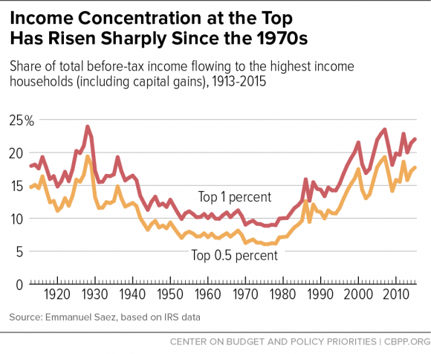
The share of US income going to the top is now back to what it was in the 1920s.
Chad Stone et al, CBPP, Sept 30, 2016 www.cbpp.org/research/poverty-and-inequality/a-guide-to-statistics-on-historical-trends-in-income-inequality

Slide 14
Why has inequality risen in the US?
  Trade probably does play a role, alongside other factors:
  technological change raising demand for skilled workers,
  outpacing education that raises the supply;
  “winner-take-all” labor markets,
  “assortative mating,”
  reduced corporate competition & higher rents,
  excessive executive compensation;
  and Thomas Piketty’s wealth accumulation.
  Other suggested factors:
  declining roles of unions, minimum wage, & progressive taxation.

Slide 15

2. Widening gap between “skilled” & “unskilled” workers, defined by college graduation.
Jason Furman, CEA, Oct. 17, 2016, Fig.10.

Slide 16

3. Trend in years of education slowed during 1981-2012.
Mean Years of Schooling at Age 30, U.S. Native-Born, by Year of Birth, 1876-1982
Trend
1906 – 1981
= 1876+30 to 1951+30.
Trend
1981 – 2012
= 1951+30 to 1982+30.
Jason Furman, CEA, Oct. 17, 2016, Fig.11.

Slide 17

4. “Winner take all” labor markets
    Taylor Swift earned $170 million last year, making her
    the world’s highest paid celebrity (according to Forbes).

Slide 18

5. “Assortative mating”
    Crudely put: highly educated
    & highly paid male professionals
    used to marry their secretaries,
    but now are more likely
    to marry highly educated & (relatively) highly paid women;
    and the couple passes the advantages on to their children.

Slide 19
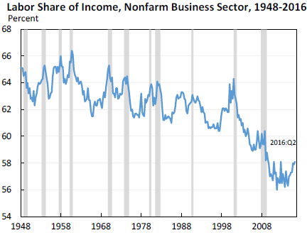
6. The share of US national income going to labor has declined since 2000 in part due to increased market power of firms, says Furman.
Jason Furman, CEA, Oct. 17, 2016, Fig.13.

Slide 20
7. Excessive compensation?
Many top-1%-ers are executives and/or in finance.
Composition of Top 1 Percent Income Share by Primary Occupation
Jason Furman, CEA, Oct. 17, 2016, Fig.4a.

Slide 21
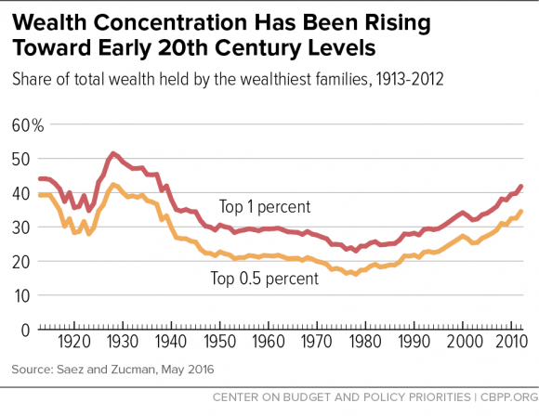
8. Piketty: The share of wealth at the top has also been rising.
Chad Stone et al, CBPP, Sept 30, 2016 www.cbpp.org/research/poverty-and-inequality/a-guide-to-statistics-on-historical-trends-in-income-inequality

Slide 22
On the other hand, the big increase in inequality has been within labor (and within capital).
Jason Furman, CEA, Oct. 17, 2016, Fig.15.

Slide 23
What weights should we place on each of these 8 factors in explaining increased inequality?
I don’t know.
Probably all or most of them merit some weight:
Trade, technology, education, winner-take-all, assortative mating, rents, executive compensation, or Piketty’s wealth accumulation.
Surely one must diagnose the cause before deciding on the corresponding remedy?
No, I don’t think one has to.

Slide 24
The Second Fundamental Welfare Theorem.
When individuals are free to engage in trade, the size
of the economic pie increases enough that the winners
could in theory compensate the losers,
  in which case everyone would be better off.
Skeptics of globalization may understand this theorem
and yet, reasonably, point out that the compensation
in practice tends to remain hypothetical.
They suggest that we should take the political failure
to compensate losers as given, and so try to roll back globalization.
  But an alternative would be the reverse strategy:
  take globalization as given and instead
  work on trying to help those left behind.
  This is the sensible strategy.
    Why?

Slide 25
Even leaving aside the negative effects
of trade wars on economic growth,
  and the geopolitical damage,
nothing a president does could bring the number of manufacturing jobs back up anywhere near
the levels of 60 years ago.

Slide 26

We are not going back to 1950, when manufacturing jobs were 32% of the national total vs. down to 10% by 2010
-- any more than we are going back to 1790
when farmers were 90% of national employment, vs. 2% today.
Percent of employment in US manufacturing (1970-2012)

Slide 27
Some of those lost jobs were in autos & steel,
where those northern workers who lacked a college education but were lucky enough to get a job in those two industries could earn a high income.
After 1960, the number of jobs in sectors like steel fell by ½;
  while the number of jobs in health care increased 6-fold.
International trade was one factor that helped put an end to those high-paying jobs (along with productivity growth and relocation from the north to the south)
  while improving the reliability, fuel efficiency and affordability
  of cars for all of us
  not just importing autos,
  but also making US autos competitive again.
Regardless, it is hard to see how we could go back.

Slide 28
The most effective policies to help those left behind
(“to compensate the losers”):
The program to help specifically those losing their jobs due to trade is Trade Adjustment Assistance.
  But why help only the small number of workers
  who have identifiably lost their jobs due to trade agreements?
  Wouldn’t it be better to help those who have been left behind regardless if the cause is trade, technology, or something else?
    and to do it in ways that still reward work.

Slide 29
Sensible policies to help those left behind include:
Wage insurance;
More progressive income tax system
  including an expanded Earned Income Tax Credit,
  And more progressive payroll tax rates too;
Universal health insurance.
Universal high-quality pre-school education;
infrastructure investment spending;
Financial regulation, such as Dodd-Frank.
Some politicians oppose these measures,
  arguing that government overreach impedes growth.

Slide 30
Appendices
Appendix 1: A century of US trade liberalization
  Job losses in manufacturing
Appendix 2: Trade theory
Appendix 3: Opinion polls on trade
Appendix 4: Trade and the environment
Appendix 5: Improved global income distribution.
Appendix 6: For each of 8 inequality diagnoses, one might think of a targeted policy response.
Appendix 7: The outlook for the US trade deficit.

Slide 31
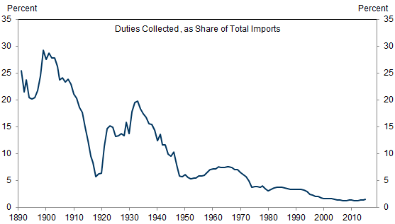

Appendix 1: US Import Tariff Rates have Declined to Historical Lows
Data Source: US International Trade Commission
Struyven, 30 Sep 2016, US Economics Analyst: The Economics of Higher Tariffs

Slide 32
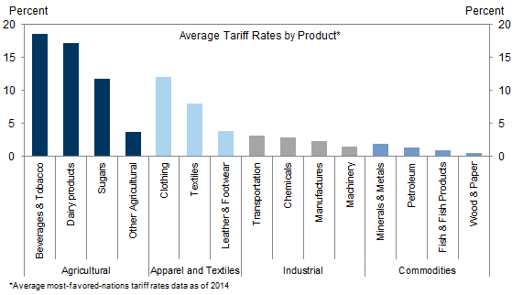
US Tariffs are Low Except On Agriculture & Apparel
Source: World Trade Organization
Struyven, 30 Sep 2016, US Economics Analyst: The Economics of Higher Tariffs

Slide 33
The evolving employment mix
Jobs in clothing and steel fell by half
while the number of jobs in health care increased six-fold:

Slide 34
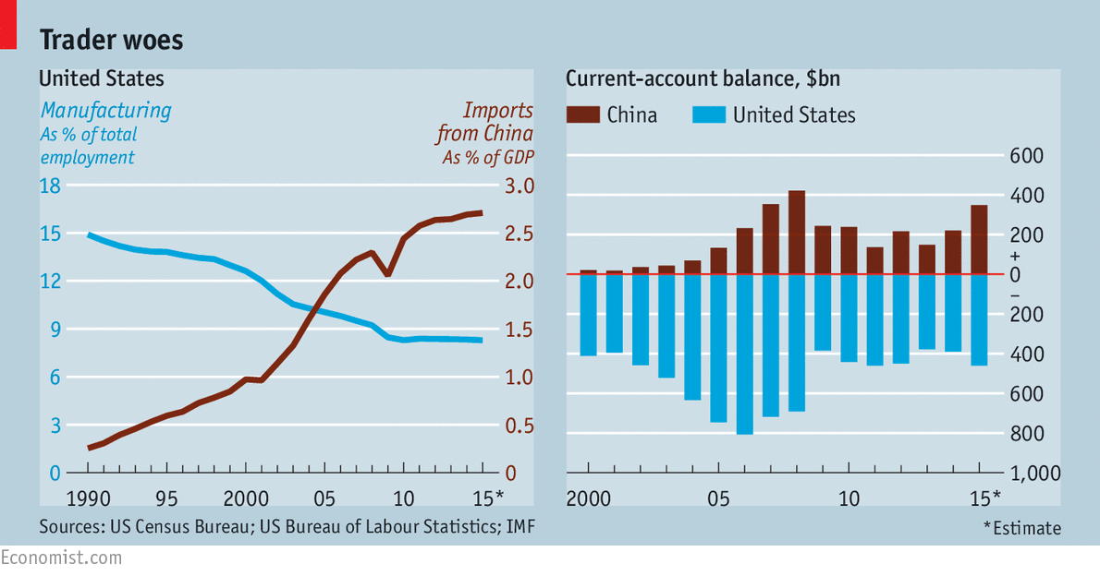
Some of the decline in US manufacturing jobs can indeed be associated with imports, especially from China.
according to David Autor, David Dorn and Gordon Hanson,
The China shock: Learning from labour market adjustment to large changes in trade”, NBER WP 21906, 2016. And “The China syndrome: Local labour market effects of import competition in the United States”, American Economic Review, 2013.
Economist, Feb 6th 2016,
“Trade in the balance: Globalisation can make everyone better off. That does not mean it will”

Slide 35
Appendix 2: Trade theory
Throughout the history of international economics, theory has generally said that trade helps raise real national income:
  classical comparative advantage (Ricardo);
  and modern theories of trade
    based on imperfect competition (Krugman)
    & endogenous productivity (Melitz).

Slide 36
What does trade theory say about income distribution?
Ironically, the trade theory that dominated academic research during the 1950s-70s was Heckscher-Ohlin-Samuelson,
which gives solidly respectable grounds for fearing trade
would hurt American workers even in absolute terms.
It divides the population into “Unskilled” workers vs. others (owners of capital or land, or skilled workers)
  The Stolper-Samuelson theorem specifically predicts that workers in a capital-abundant country will lose from trade (wages fall), even though total real national income goes up.
The H-O-S theory does not include the advances in trade theory since 1980.
Still, its conclusions are very suggestive,
  particularly regarding trade with low-income countries.

Slide 37
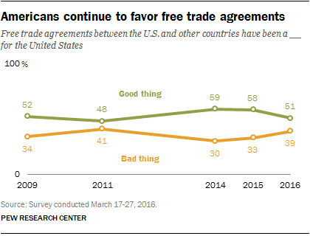
Appendix 3: Polls tend to show Americans support trade

Slide 38
Polls tend to show Americans support trade
A survey last month by the nonpartisan Pew Research Center found
  Americans by 50 to 42 % said trade agreements had been “a good thing” for the US.
July Washington Post-ABC News poll. Asked if they wanted the next president to support trade agreements or oppose them,
  75 % of respondents said they wanted a supporter
  Vs. 17 percent favored an opponent.
A Gallup poll early this year found that
  58 percent of Americans viewed
  trade as an economic opportunity,
  34 percent as a threat.
Similarly, in a July poll for NBC News,
  55 % of registered voters agreed with a statement that trade was good “because it opens up new markets and we cannot avoid the fact that it is a global economy,”
  while 38 % agreed trade was bad “because it has hurt manufacturing and other key industries.”
Source: NY Times Sept. 21, 2016 “Who Hates Free Trade Treaties? Surprisingly, Not Voters”

Slide 39

Appendix 4: Trade can have either positive or negative effects on the environment.
Example of negative effects:
  “Race to the bottom” in environmental regulation among national governments pursuing of cost-competitiveness.
Example of positive effects:
  Trade in environmental goods & services.
    US ended 1980s tariffs & quotas on fuel-efficient Japanese autos, benefiting both consumer pocketbooks & air quality.
    Almost ¾ of EU trade-remedy barriers currently target imports
    of products used for renewable energy! (Kasteng, 2013; Wu, 2014)
    AD remedies currently block trade in solar power inputs:
      US has AD tariffs on imports of Chinese solar panels (2012, 2014, 2015).
      China has them against imports of polysilicon from US & EU (2012 & 2016);
      EU has penalties on imports of Chinese solar glass & panels (2013, 2015).
      They should be dropped, either by negotiation or unilaterally.

Slide 40
Which tend to dominate in practice, positive or negative effects of trade on the environment?
Econometric estimates depend on environmental criterion.
For SO₂
  Trade seems to be beneficial
    “Environmental Kuznets Curve” =>
    at higher incomes, people want to clean the environment.
For CO₂
  Even at high levels of income, trade continues to hurt.
    The “free rider” problem => popular desire for environmental quality cannot be enacted at the national level, absent an effective multilateral treaty à la Paris Agreement.
Frankel & Rose, Review of Ec. & Stats. (2004).

Slide 41
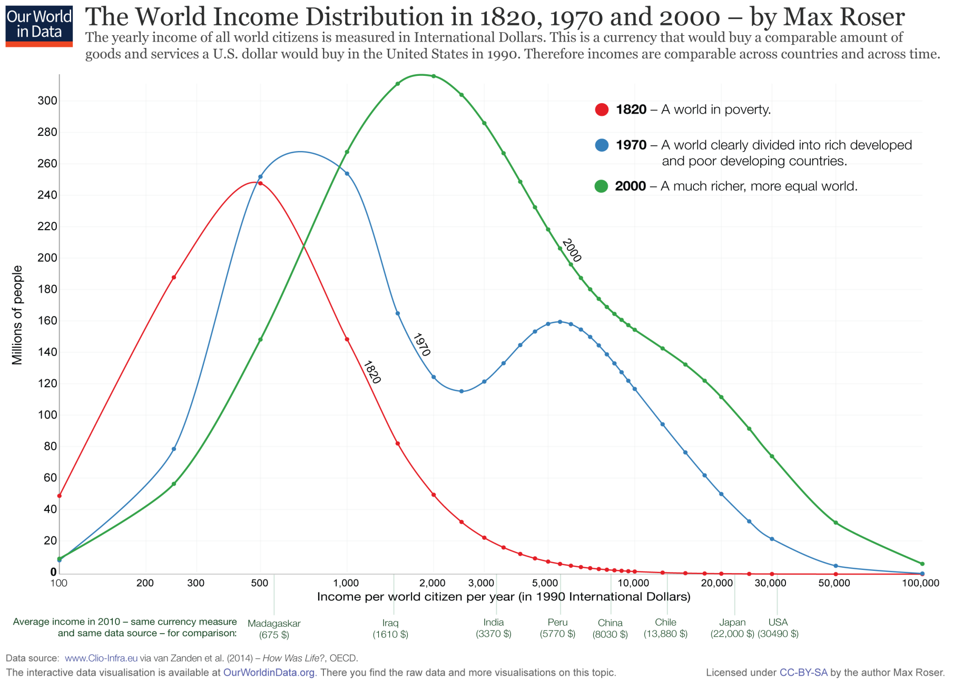
Appendix 5: Global inequality fell sharply 1970-2000.
https://ourworldindata.org/global-economic-inequality
Over the last 25 years, poverty has fallen especially rapidly in such countries as China, Indonesia & India

Slide 42
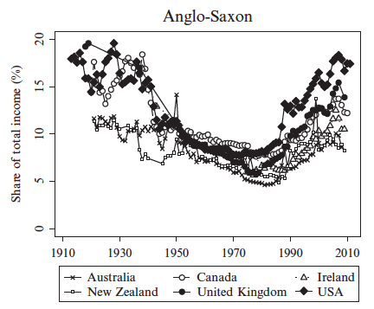
But the UK and Canada have shown the same within-country inequality pattern as the US.
Source: Roine & Waldenstrom, (2015), Handbook of Income Distribution, 1870-2010
Thanks to Gita Gopinath
Notes:
1980 turning point

Slide 43
Appendix 6: For each of the 9 inequality diagnoses, one might think of a targeted policy response:
1. Trade
  Trade Adjustment Assistance or, better yet, wage insurance.
2. Technology and 3. education
  Make college more accessible to lower-income students.
4. “Winner-take-all” labor markets.
  An rise in income taxes & payroll taxes for the upper 0.1%.
5. “Assortative mating”
  Education again, especially universal pre-school.
  …

Slide 44
For each of the 9 inequality diagnoses, a targeted policy response, continued:
…
6. Reduced corporate competition and increased monopoly rents
  More aggressive anti-trust action.
7. Executive compensation, especially in finance
  Reforms such as “say on pay,” separating the function of CEO
  & Chairman of the Board, “claw-back provisions,” and so on;
  Continued financial reform, begun under Dodd-Frank
    e.g., risk-tax on large financial institutions.
  Higher tax rates on the upper 0.1% and, very specifically, eliminating the carried-interest deduction.
8. Piketty’s wealth accumulation:
-- Inheritance tax, at least on estates above $5 million.
9. Less progressive income tax since 1981.
-- Could reverse that.

Slide 45
9. Taxes & transfers have done a bit to narrow the income decline of the bottom 50%
(but not as much as in other countries).
Piketty, Saez, & Zucman, Dec. 2016, “Distributional National Accounts: Methods and Estimates for the United States.” http://gabriel-zucman.eu/files/PSZ2016.pdf

Slide 46
Tax rates for the upper 1% fell after 1943-70, and for the bottom 50% rose.
Piketty, Saez, & Zucman, 2016
Fig. 10, p.48. Notes: The top panel depicts the macroeconomic tax rate (total taxes to national income), and the average tax rate of the top 1% and bottom 50% pre-tax income earners, with income equally split among spouses. Taxes include all forms of taxes at the federal, state, and local level. Tax rates are expressed as a fraction of pre-tax income.

Slide 47
Appendix 7: Outlook for the US trade balance
Little-known fact: The US trade deficit has been narrowing for the last 10 years as a share of GDP
  [See graph.]
Mr. Trump’s policies are likely to put the
trade deficit back on a deteriorating path,
  even if he doesn’t stop China from intervening
  in the foreign exchange market.

Slide 48
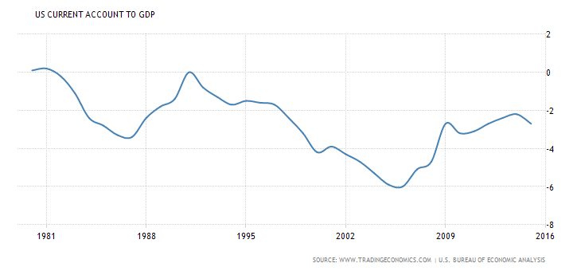
The US trade deficit as a share of GDP
has narrowed over the last ten years.

Slide 49
  What causal channel would widen the trade deficit?
Fiscal expansion would put upward pressure on interest rates, especially since we are already essentially at full employment.
  The Fed had already been expected to raise interest rates Dec. 14.
  Recent developments augur more interest rate hikes in 2017 & 2018.
  The new Administration will probably oppose the increases
    notwithstanding that the candidate has attacked the Fed for keeping interest rates too low.
    One hopes the Fed’s independence will hold, as it did under Volcker.
That will also put upward pressure on the dollar:
  Because higher interest rates attract a capital inflow, as in the classic Mundell-Fleming model (BD ↑ => NS↓ => i rate ↑ => $ ↑)
  Mr. Trump is doing more to depreciate other currencies
  against the $ than currency manipulation does.
Indeed the increases in US interest rates and the value
of the dollar are already underway, ever since the election.
[See graph.]

Slide 50
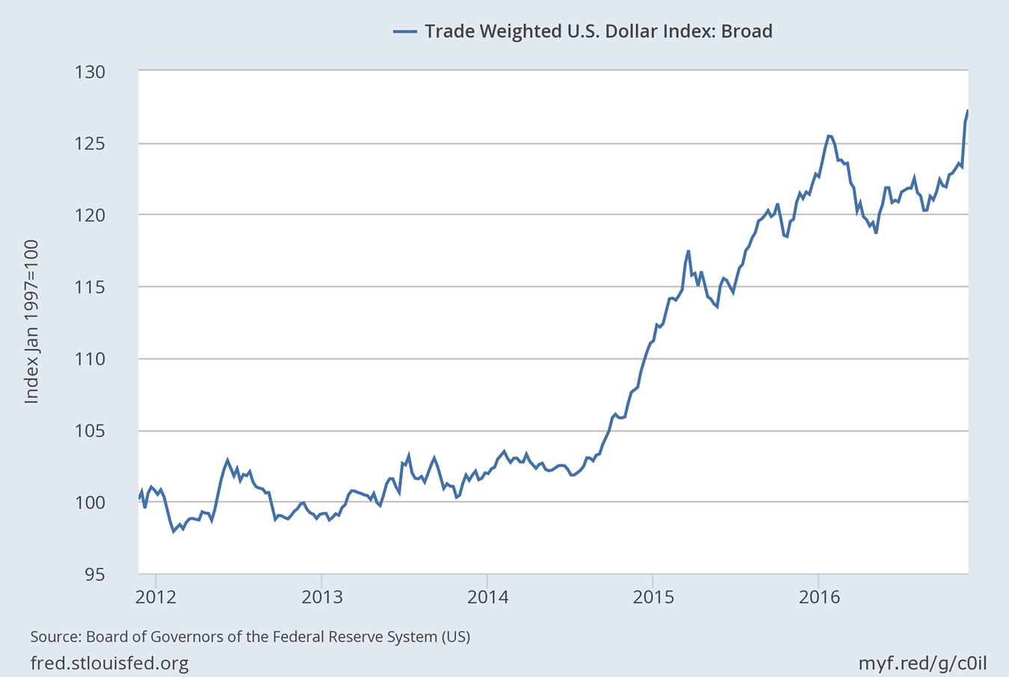

After the election the dollar appreciated against a broad set of currencies.
Nov. 9, 2016
Nov. 8: 122.8
Nov. 25: 127.9
https://fred.stlouisfed.org/series/TWEXB

Slide 51
Appendix 8: The argument for TPP
As with most previous trade agreements, the net economic effect is positive, on both sides.
Specific examples of American sectors that are likely to gain exports are in:
  Agriculture
  -- dairy to Canada, poultry to Vietnam; beef, pork, soy & wine to Japan.
  Services – engineering, education, software, express delivery services…
  Manufactures – ICT hardware (& autos, machinery…)

Slide 52
Overview of other aspects of TPP
TPP differs from past agreements, as both supporters & detractors point out.
  So-called “deep integration
  Most prominently, it addresses:
    some areas of particular concern to the left, such as
      the environment
      and labor rights
    and some areas of particular concern to the right, such as
      IPR
      and investor-state dispute settlement.
  Of course TPP is politically unpopular,
    in part, because many workers feel left behind by modern trends
      a valid point that we should discuss further.
  But, few critics know what is actually in the agreement.

Slide 53
Environmental (Chapter 20)
Steps to help implement at the national level bans on trade in endangered wildlife
  under CITES (Conventn. On Int. Trade in Endangered Species)
  but insufficiently enforced until now.
  E.g., rhinos, elephants, tropical birds, and rare reptiles.
Steps to protect the ocean environment from ship pollution.
& to limit subsidies for fishing fleets,
  which subsidize depletion of tuna, & swordfish…
For the 1st time in a regional agreement, these provisions are subject to a dispute settlement process backed up by threat of trade penalties.

Slide 54
Labor practices (Chapter 19)
  Including steps to promote union rights in Vietnam
    allowing independent labor unions for the first time
    VN agreed bilaterally to make labor regulations consistent with the US, or forfeit tariff concessions on clothing & textiles.
  As with enviro, dispute settlement & trade penalty threat backs up commitment to labor provisions.

Slide 55
In two particular areas, critics were afraid that the final agreement would give too much to US corporations such as tobacco & pharmaceuticals.
This could have happened, given that Pres. Obama needed Republican votes for TPA.
  But these industries did not get what they wanted.
ISDS, e.g.,
  might have interfered unreasonably with countries’ anti-smoking campaigns.
  But, no. Australia is free to ban brand name logos on cig. packs.
IPR, e.g.,
  TPP might have extended to other countries our 12-year protection for data on new drugs from our pharma and bio-tech. companies.
  But, no, the most they get is 8 years in some countries
    (5 years in others, with other measures).

Slide 56
  Geopolitics
If, as expected, the US Senate fails to ratify TPP, the Asian members will conclude that the US has lost interest in their region
  and perhaps has lost the capacity to lead globally.
As a result, they will conclude they have no choice but to draw closer to China.
  It has already happened:
    AIIB
    RCEP…

